Slide 1
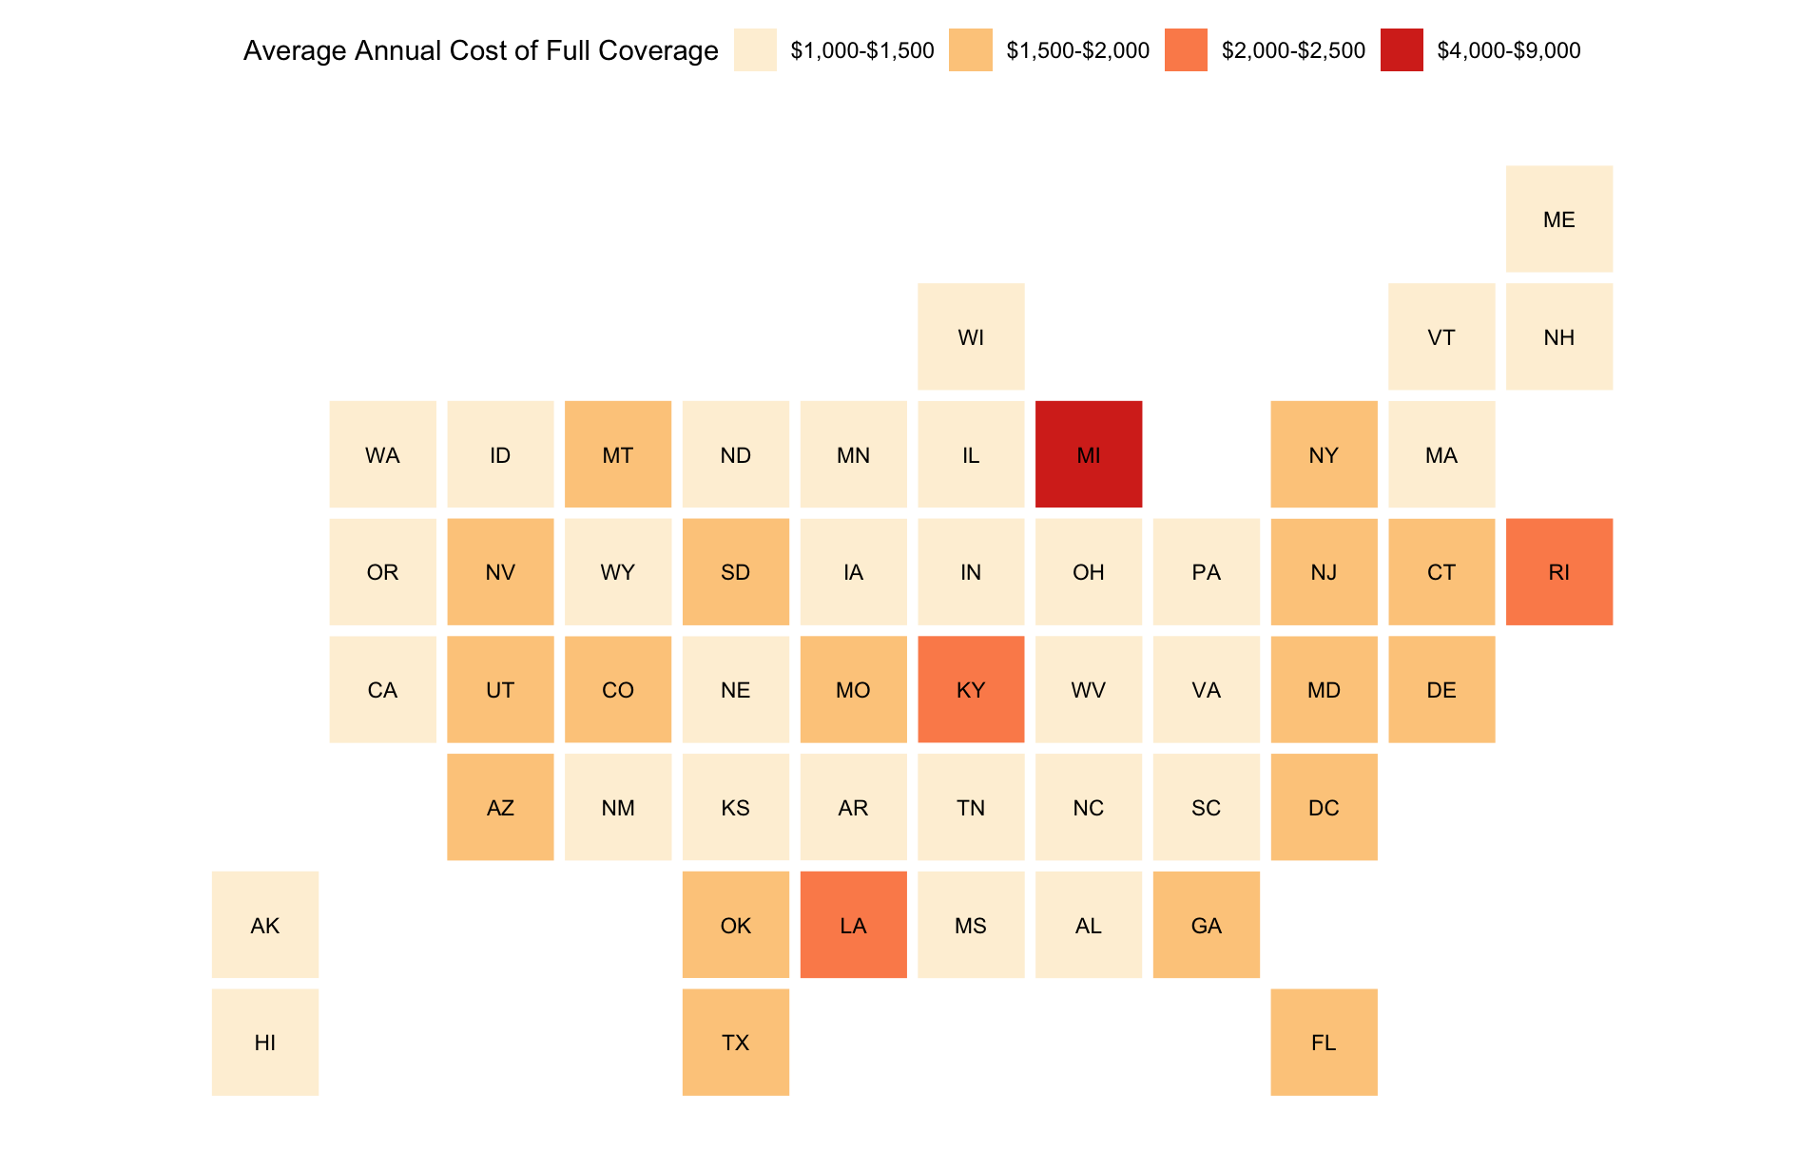
Michigan’s Full Coverage Car Insurance is the Most Expensive in the Country
Michigan’s average annual full coverage came out at $8,723 because of the state’s no-fault laws and unlimited personal injury protection coverage.
Visualization by Alex Elfering; Source: ValuePenguin

